Slide 1
Many Ways to Make a Sample Do you know some?

Slide 2
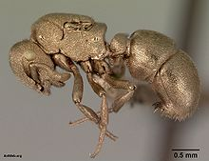
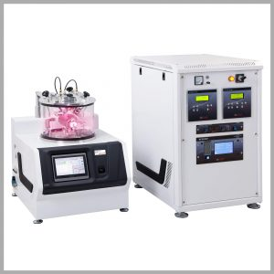
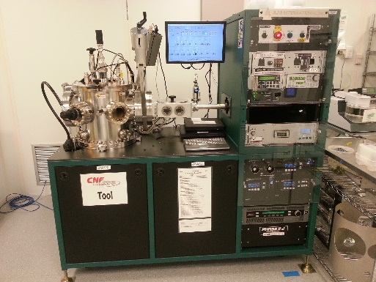
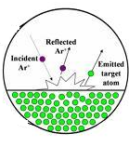
Sputtering
Sputtering is a term used to describe the mechanism in which atoms are ejected from the surface of a material when that surface is struck by sufficiency energetic particles
Discovered in 1852
Most utilized for metals
Very easy and quick
Great for uneven surfaces
Often for electron microscopy
Lower crystalline quality
Notes:
Electron microscopy doesn’t work well for charged surfaces

Slide 3
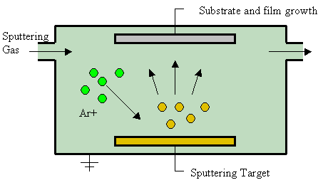
Sputtering
There are different ways to give the collision material energy. High voltage shown here (common approach).
Not always argon.
The atomic weight of the gas should be close to the atomic weight of the target.
Light elements: neon
Heavy elements: krypton or xenon.
Reactive gases can also be used.
vacuum
Notes:
Sputtered atoms ejected from the target have a wide energy distribution, typically up to tens of eV (100,000 K). The entire range from high-energy ballistic impact to low-energy thermalized motion is accessible by changing the background gas pressure.
For efficient momentum transfer, the atomic weight of the sputtering gas should be close to the atomic weight of the target, so for sputtering light elements neon is preferable, while for heavy elements krypton or xenon are used. Reactive gases can also be used to sputter compounds.

Slide 4
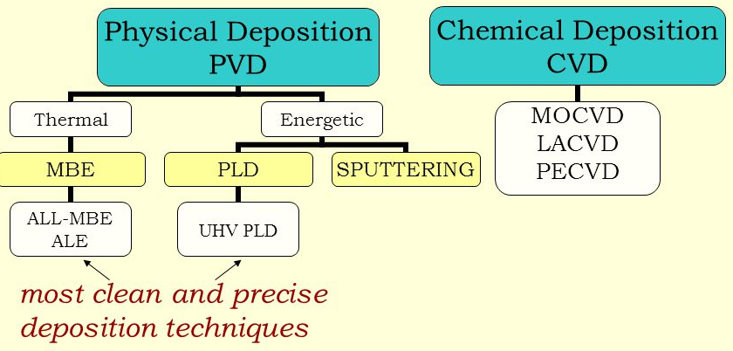
See pages 247 – 249 in Holgate
MO = metalorganic
LA = laser assisted
PE = plasma enhanced
ALD
PLD = pulsed laser deposition
MBE = molecular beam epitaxy
CVD = chemical vapor deposition
ALD = atomic layer deposition
Most common growth techniques in condensed matter physics
Notes:
I’m not personally seen laser assisted

Slide 5
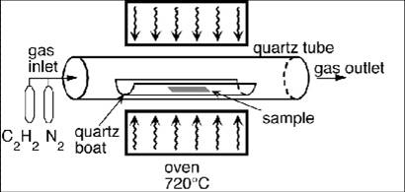
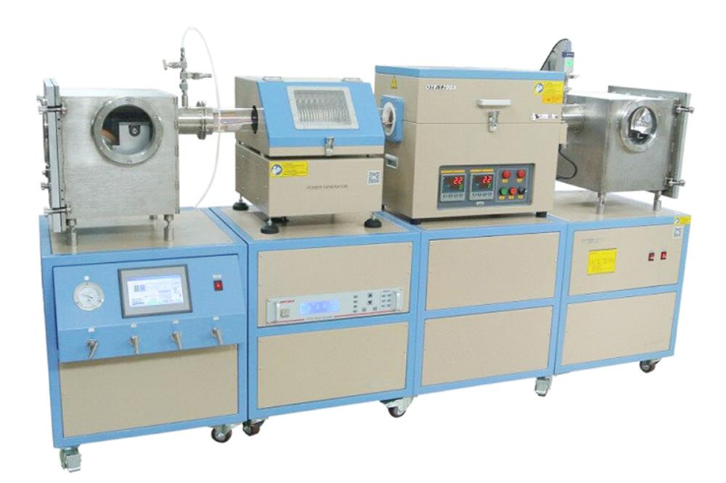
Notes:
My graduate group used three different techniques: PLD, UHV-PLD and CVD. PLD and CVD provided similar quality, but not has good as UHV PLD. But not trivial to transfer the recipe from chamber to chamber.
In CVD, heat is used to decompose the gas rather than a plasma source (compare with sputtering or glow-discharge)
CVD is relatively easy to industrialize
Chemical vapor deposition (CVD) is a chemical process used to produce high quality, high-performance, solid materials. The process is often used in the semiconductor industry to produce thin films. In typical CVD, the wafer (substrate) is exposed to one or more volatile precursors, which react and/or decompose on the substrate surface to produce the desired deposit. Frequently, volatile by-products are also produced, which are removed by gas flow through the reaction chamber. A disadvantage is that you have to figure out the precursors, which isn’t always obvious by chemistry. I may also not be as easy to grow smoothly, depending on the material.
Atomic layer deposition (ALD) is a thin film deposition technique that has gained in popularity recently. I don’t know much about it so I can’t tell you if that popularity is warranted. ALD is based on the sequential use of a gas phase chemical process. ALD is considered a subclass of chemical vapour deposition. The majority of ALD reactions use two chemicals, typically called precursors. These precursors react with the surface of a material one at a time in a sequential, self-limiting, manner. Through the repeated exposure to separate precursors, a thin film is slowly deposited. ALD is a key process in the fabrication of semiconductor devices, and part of the set of tools available for the synthesis of some nanomaterials.

Slide 6
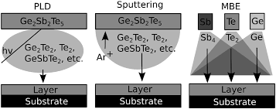
See pages 247 – 249 in Holgate
ALD
PLD = pulsed laser deposition
MBE = molecular beam epitaxy
CVD = chemical vapor deposition
ALD = atomic layer deposition
Most common growth techniques in condensed matter physics
Notes:
Use graph to transition to high quality growth

Slide 7
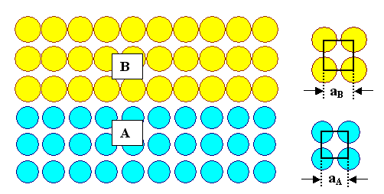
Most of Thin Film Research
Ultimate goal:
Epitaxial growth = growing a film with matched lattice parameter a to substrate lattice parameter
Purpose:
To study and/or manipulate material properties or design ultrathin devices
Also stoichiometric and smooth!
Notes:
Discuss ABO3 and ABO2 to mention why stoichiometry is not always easy to obtain. Can check by XRD, as we’ll learn soon.

Slide 8
Atomic Layer Deposition (ALD)
Nice video: https://youtu.be/HUsOMnV65jk
An advantage of ALD is the ability to coat complex items while maintaining quality.
More expensive and tricky than sputtering.
More chemical involvment
Generally, a trade off between ease and quality.

Slide 9
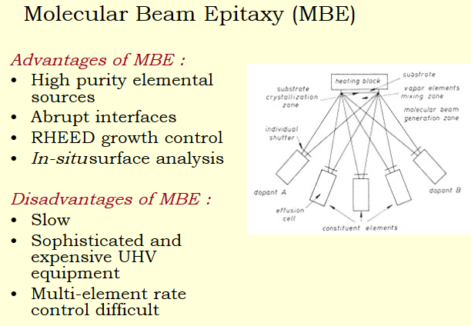
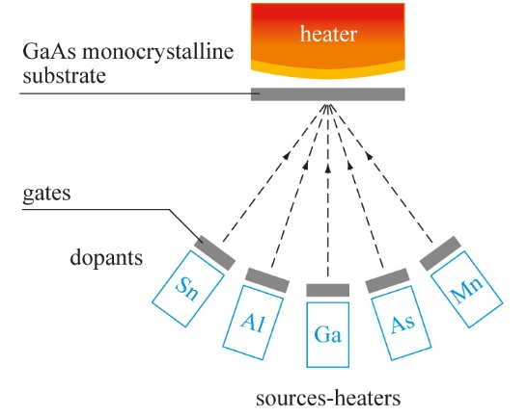

Slide 11
Great for semiconductors and topological insulators

Slide 12
Great for semiconductors and topological insulators

Slide 13
(or Laser)

Slide 14
(or Laser)

Slide 15
(or Laser)

Slide 16
(or Laser)

Slide 17
(or Laser)

Slide 18
(or Laser)

Slide 19
(or Laser)
Rotating the target and/or substrate improves uniformity

Slide 20
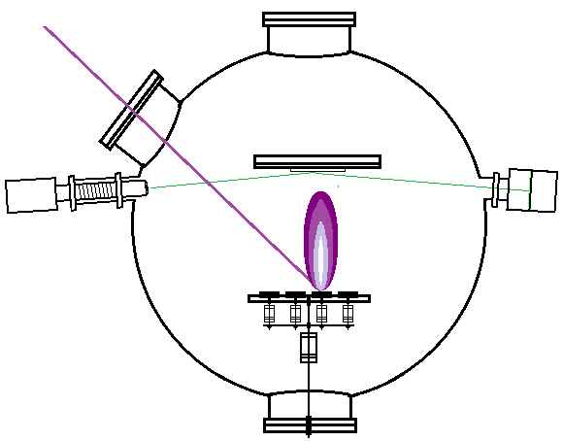
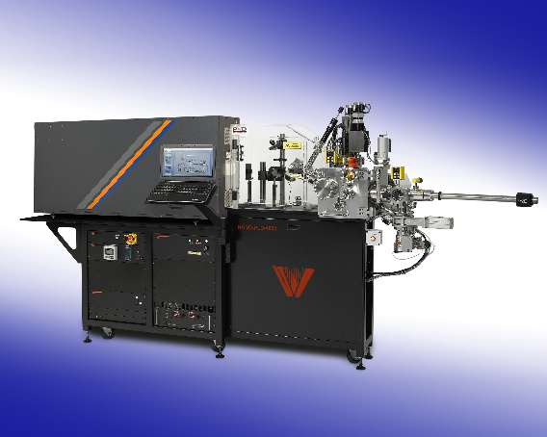
Both MBE and PLD use RHEED to optimize (Reflection High Energy Electron Diffraction)
Laser (often 248 nm)
Substrate
Electron Detector
Electron Gun
MBE
Target(s)
Laser
Pulsed Laser Deposition (PLD)

